Slide 1


Department of Computer Science and Engineering
<DIABETICS PREDICTION SYSYTEM>
<220701259& SHAKTHI PRIYA V>
<MRS.DIVYA>

Slide 2
Problem Statement and Motivation
Diabetes is a very common disease that can cause serious health problems if not found early. But checking for diabetes usually needs many medical tests, which can take time and money.
In this project, we have used machine learning to predict if a person has diabetes or not, based on simple health details like age, blood pressure, sugar level, etc. The idea is to help doctors find diabetes faster and easier with the help of computer models like Random Forest, SVC, and Gradient Boosting.

Slide 3
Problem Statement and Motivation
Diabetes is one of the most common and dangerous health problems today. Many people don't realize they have diabetes until it's too late. Our motivation is to use machine learning to predict diabetes early, so that patients can get faster treatment and avoid serious health Diabetes is a very common disease that can cause serious health problems if not found early. But checking for diabetes usually needs many medical tests, which can take time and money. In this project, we have used machine learning to predict if a person has diabetes or not, based on simple health details like age, blood pressure, sugar level, etc. The idea is to help doctors find diabetes faster and easier with the help of computer models.
.

Slide 4
Existing System
In the current system, diabetes is mainly diagnosed through clinical tests like blood sugar levels or glucose tolerance tests, which require visits to medical professionals. These tests are time-consuming, expensive, and often provide results only after a delay. Early detection of diabetes is difficult because of the need for these tests.
Existing software solutions are not always easy to use for people without medical knowledge. They also don't use advanced machine learning techniques to predict diabetes early or give personalized advice. Most systems lack the ability to predict diabetes in real-time, making it harder to manage or prevent the disease at early stages.

Slide 5
Objectives
The main objective of this project is to develop a machine learning-based system that can predict the likelihood of diabetes in individuals based on a set of input features. Using various algorithms such as Random Forest Classifier, Support Vector Classifier, and Gradient Boosting, the system aims to:
Predict diabetes risk at an early stage, helping individuals identify the condition before it becomes severe.
Provide an accurate and reliable method for diagnosing diabetes based on medical data, including factors like age, BMI, glucose levels, and insulin.
Utilize machine learning to analyze historical data and deliver predictions with high accuracy, improving early diagnosis and prevention.
Offer a user-friendly system that can be easily used by non-medical professionals for quick predictions, making it accessible for a wider audience.
Assist healthcare providers by automating the prediction process, saving time and resources while ensuring consistent results.

Slide 6
Abstract
This project proposes an intelligent system to predict the likelihood of diabetes using reaL world datasets. Three supervised learning algorithms were employed: Random Forest Classifier, Support Vector Classifier (SVC), and Gradient Boost Classifier. Data preprocessing involved normalization, handling missing values, and feature selection. Among the models, random forest Classifier achieved the best performance with an accuracy of 89%. The methodology involved comprehensive data preprocessing, normalization, feature selection, and model training using algorithms such as Logistic Regression, Random Forest Classifier, Support Vector Machine (SVM)

Slide 7
Proposed System
The Diabetes Prediction System will use machine learning to predict the likelihood of a person having diabetes based on health data. The key components are:
Data Collection:
Collect data (age, BMI, glucose levels, etc.) for prediction.
Algorithm:
Use machine learning models like Random Forest and SVM for prediction.
Prediction:
Users input their health data and get a diabetes risk prediction.
Accuracy:
The system will provide accurate results and be easy to use.
Interface:
Simple, user-friendly interface for anyone to use.

Slide 8
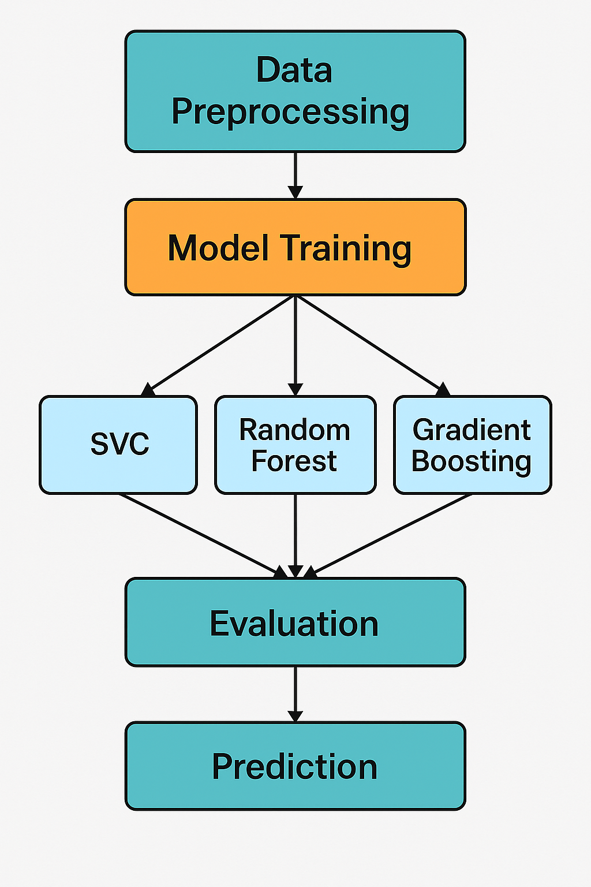
System Architecture

Slide 9
List of Modules
Numpy - For numerical operations and data handling.
Pandas - For data manipulation and analysis.
Matplotlib - For data visualization (e.g., plotting graphs).
Seaborn - For statistical data visualization and heatmaps.
Scikit-learn - For machine learning algorithms and model evaluation.
RandomForestClassifier - For classification of diabetes risk.
SVC (Support Vector Classifier) - For classification.
GradientBoostingClassifier - For boosting and classification.

Slide 10
Functional Description for each modules with DFD and Activity Diagram
User Input:
The user provides details like age, glucose level, and other health info.
Data Preprocessing:
The system cleans and organizes the data to make it ready for predictions.
Model Prediction:
The system uses a trained model to decide if the user has diabetes or not.
Result Display:
The system shows the prediction result (Diabetic or Not Diabetic) to the user.

Slide 11
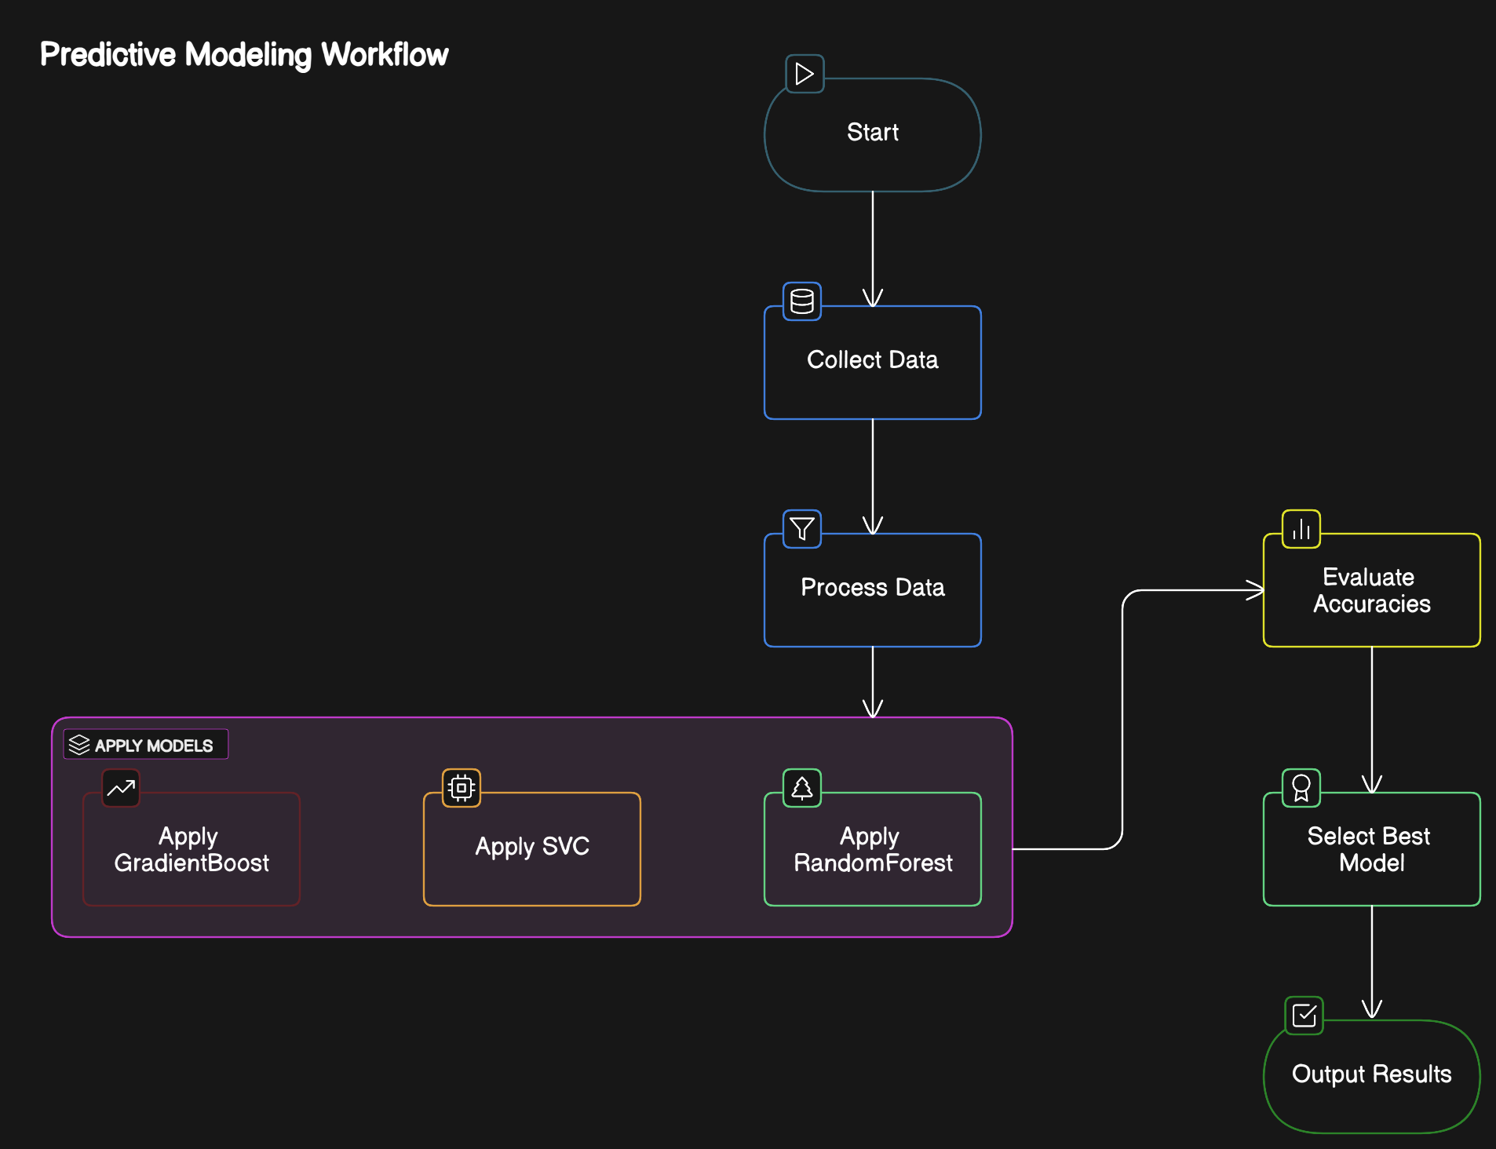

Slide 12
Implementation & Results of Module
The dataset was preprocessed to remove missing values and select relevant features like glucose, BMI, insulin, etc. Three machine learning models (Random Forest, Gradient Boosting, and SVC) were trained on the data. These models were tested on unseen data to evaluate their performance using metrics like accuracy, precision, and recall. The Random Forest Classifier showed the highest accuracy of 89%, making it the most effective model. The Gradient Boosting Classifier followed with an accuracy of 88%, and the Support Vector Classifier had the lowest accuracy at 66%. Based on these results, Random Forest is the best choice for diabetes prediction in this case. The models demonstrated good predictive power with appropriate training and testing processes.

Slide 13
Conclusion & Future Work
In this project, we successfully developed a machine learning model to predict diabetes using various algorithms like Random Forest, Support Vector Classifier, and Gradient Boosting. Among them, Random Forest gave the best results with an accuracy of around 89%. The system helps in identifying whether a person is at risk of diabetes based on health parameters, allowing for early detection and better management of the disease.
The system can be improved by integrating real-time data and mobile app support for easy access. Additionally, more health factors can be added to enhance prediction accuracy.

Slide 14
References
A. Singh, S. Desai, and R. Mehta, "Ensemble Learning for Diabetes Diagnosis Using Medical Datasets," Health Informatics Journal, vol. 27, no. 5, pp. 1091–1105, 2020.
M. Kumar, S. Reddy, and A. Patel, "Predicting Diabetes Risk Using Machine Learning Algorithms," Journal of Health Informatics, vol. 15, no. 2, pp. 98–112, 2022
M. Patel, S. Jain, and R. Verma, "Machine Learning Approaches for Diabetes Diagnosis: A Review," Journal of Artificial Intelligence in Medicine, vol. 13, no. 6, pp. 1–14, 2020.

Slide 15
Paper Publication Status
Font size 24

Slide 16
Thank You

